Slide 1
TABLEAU
CUSTOMERS
ANALYSIS
EU Superstore Sales Analysis
SALES
TRENDS
Interactive business intelligence dashboards for customer, sales and order analysis
ORDERS
DETAILS
INTERACTIVE DATA EXPLORATION
Tools: Tableau • Excel • Calculated Fields • Parameters
Prepared by: Priyanka Asalekar

Slide 2
Project Overview
A Tableau project built on the EU Superstore dataset.
This project explores retail orders and customer activity using the Orders sheet, which contains 10,000 order-line records across 20 fields.
The packaged Tableau workbook includes customer analysis, sales and order KPI sheets, delivery-time analysis, product/customer rankings, and a dynamic X–Y view that lets users choose a dimension and measure.
PROJECT FILE
DATASET
Tableau Sample EU Superstore sales analysis.twbx
Sample - EU Superstore.xlsx • Orders sheet: 10,000 rows • 20 fields
TABLEAU SUPERSTORE ANALYSIS • 02

Slide 3
Project Objectives
Use interactive Tableau views to understand retail performance from different perspectives.
Track key metrics such as total orders, customers, quantity, sales and average order value.
1
Analyze customer purchase frequency and identify top customers by sales or frequency.
2
Compare sales, profit and order behavior over time, including year/quarter/month trends.
3
Explore delivery performance and orders by ship mode, with dynamic dimension and measure selection.
4
TABLEAU SUPERSTORE ANALYSIS • 03

Slide 4
Tools & Workflow
Technology used and the process represented by the Tableau workbook.
TOOLS & TECHNOLOGY
WORKFLOW
• Tableau Desktop — worksheets and dashboards
1
Connect to the EU Superstore Excel data
• Excel workbook — Orders, Returns and People data
2
Create calculated fields and KPI worksheets
3
Build customer, sales and delivery views
• Calculated fields — AOV, delivery days and KPI totals
4
Add parameters, filters and dashboard actions
• Parameters — choose X-axis dimension, Y-axis measure and Top N
5
Combine views into interactive dashboards
• Filters and dashboard actions - interactive exploration
TABLEAU SUPERSTORE ANALYSIS • 04

Slide 5
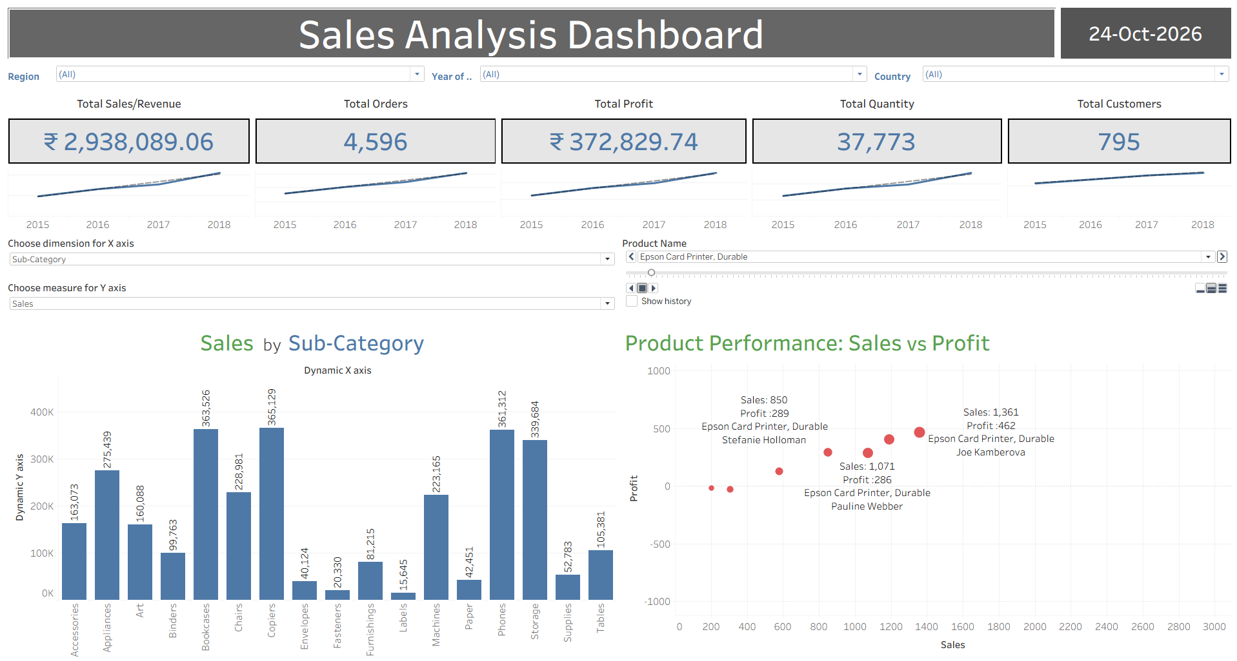
Project Visualizations -: Sales Analysis
TABLEAU SUPERSTORE ANALYSIS • 05

Slide 6
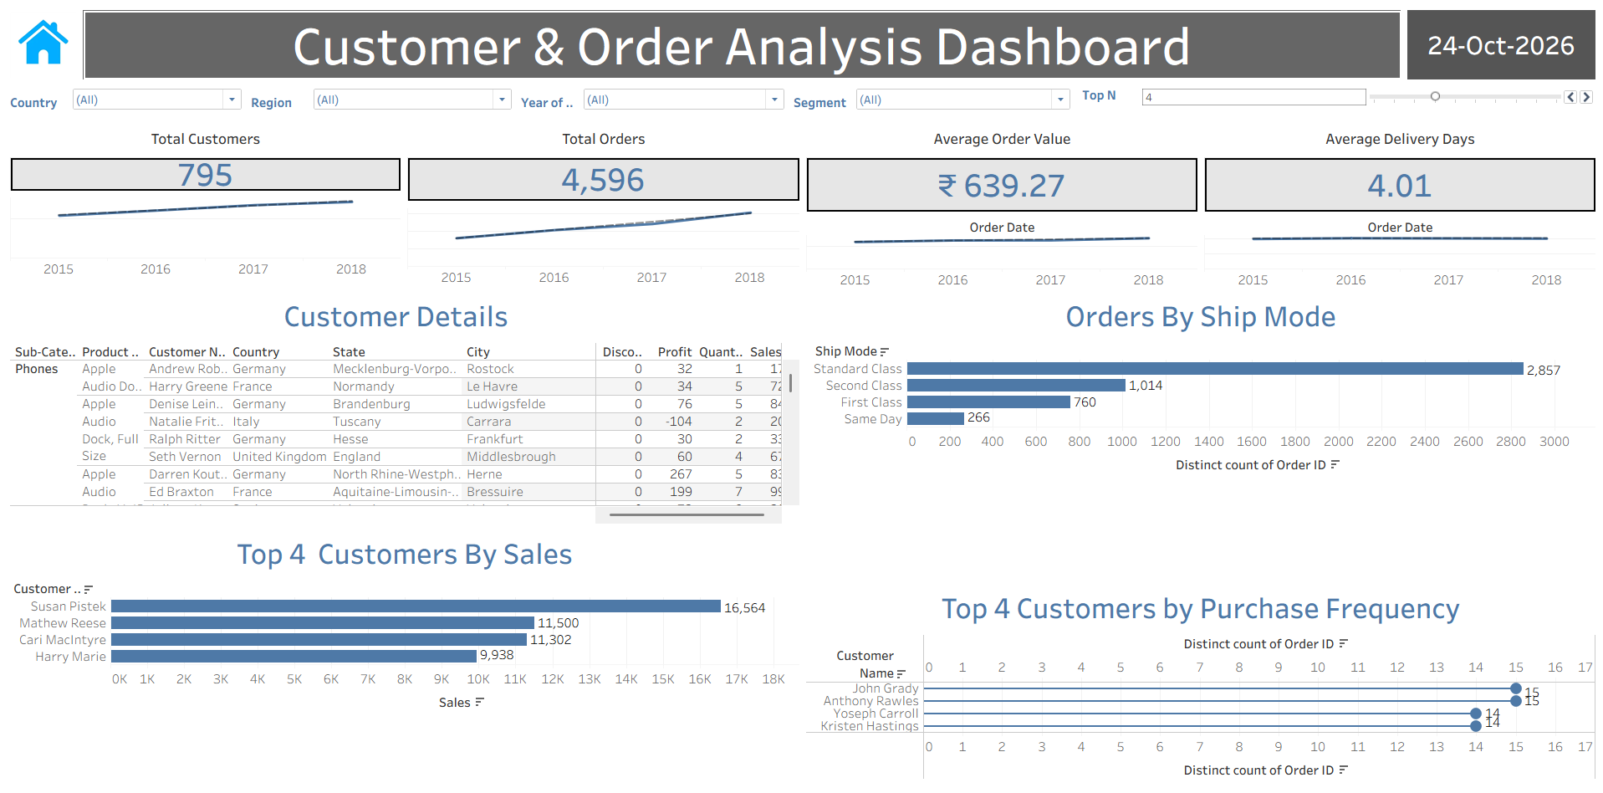
Project Visualizations -: Customer & Order Analysis
TABLEAU SUPERSTORE ANALYSIS • 06

Slide 7
Key Findings from the Dataset
TOTAL SALES
TOTAL PROFIT
UNITS / QUANTITY
DISTINCT ORDERS
₹ 2,938,089.06
₹ 372,829.74
37,773
4,596
SALES ANALYSIS
ORDER & DELIVERY PATTERNS
Top category by sales: Technology (~1.11M)
Next: Office Supplies (~1.05M)
Then: Furniture (~0.78M)
Highest-sales region: Central (~1.72M)
Average order value: 639.27
Average order-to-ship time: 4.01 days
Standard Class: 2,857 distinct orders
Second Class: 1,014 • First Class: 760 • Same Day: 266
TABLEAU SUPERSTORE ANALYSIS • 07

Slide 8
Conclusion
Summary of the project value and Tableau skills demonstrated.
This project demonstrates how Tableau can turn retail order data into interactive views for monitoring sales, understanding customer behavior and reviewing delivery performance.
KEY LEARNING AREAS
• Building worksheets and combining them into dashboards
• Creating calculated fields and KPI views
• Using parameters for dynamic X–Y analysis and Top N selection
• Applying filters and dashboard actions to explore data
TABLEAU SUPERSTORE ANALYSIS • 08

